Slide 1

talktoHadi

Slide 2
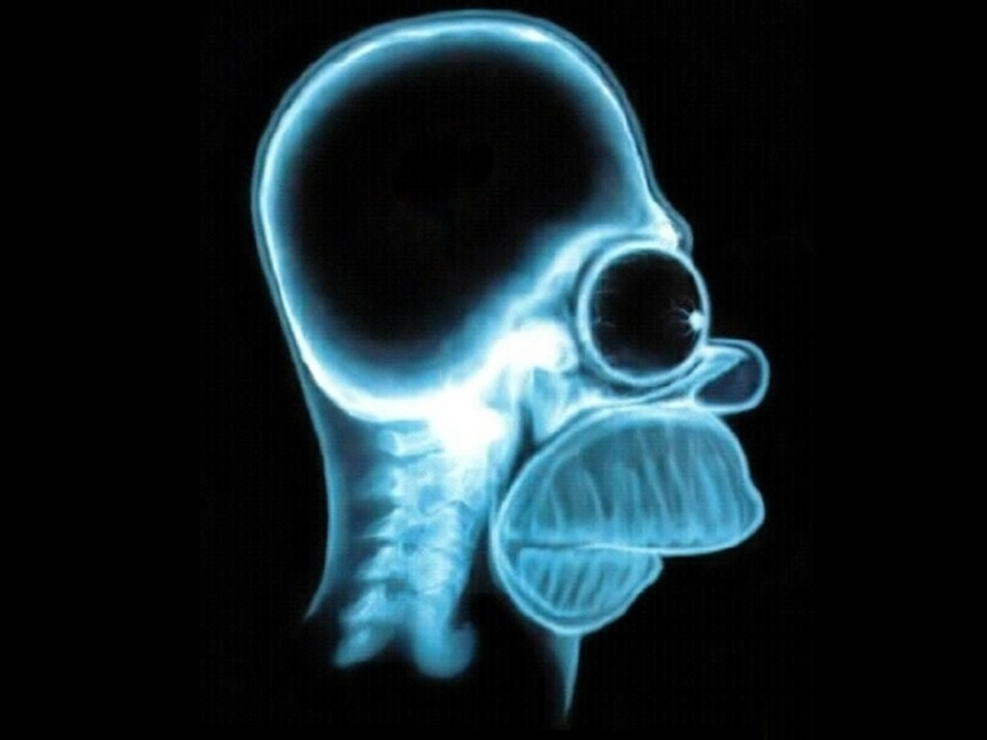
Space is Psicologycal

Slide 3
1.1 million refugees
Why talk to Hadi
30.000
psychologists

Slide 4
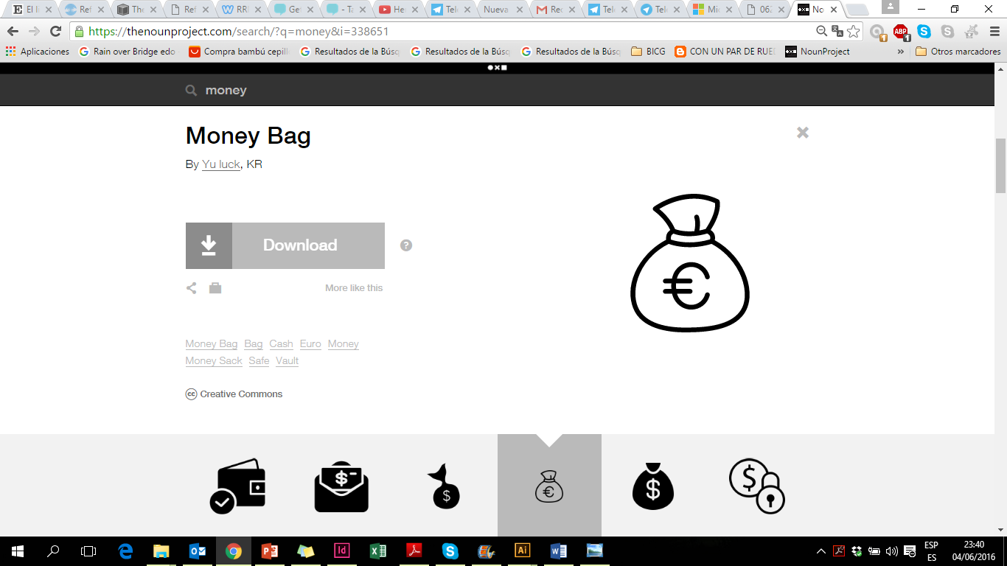
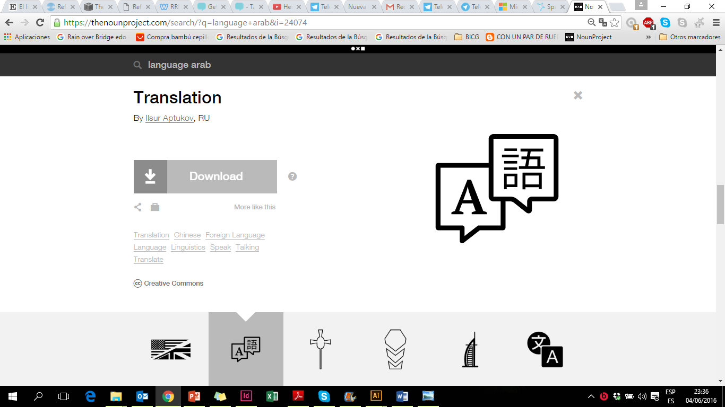
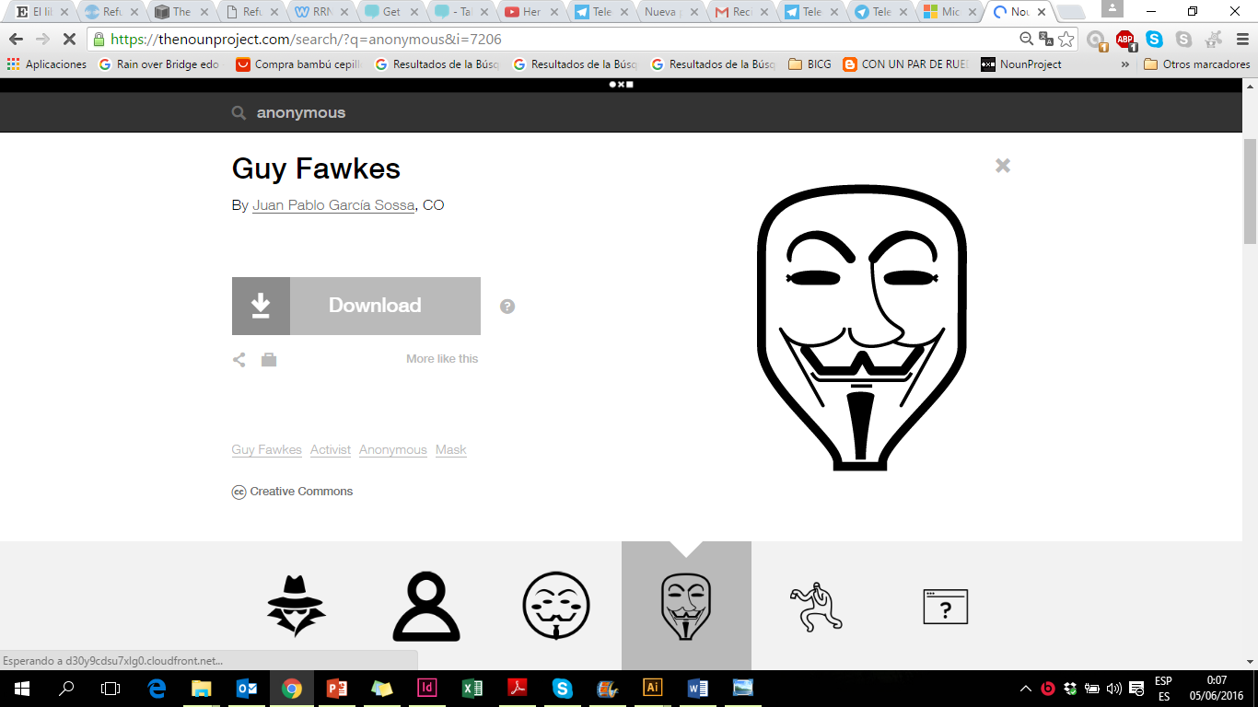
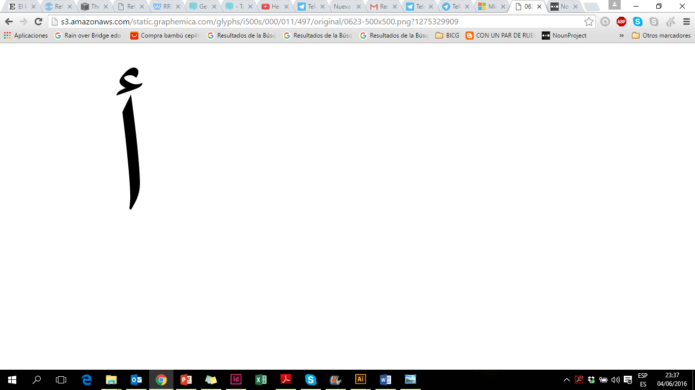
No boundaries

Slide 5
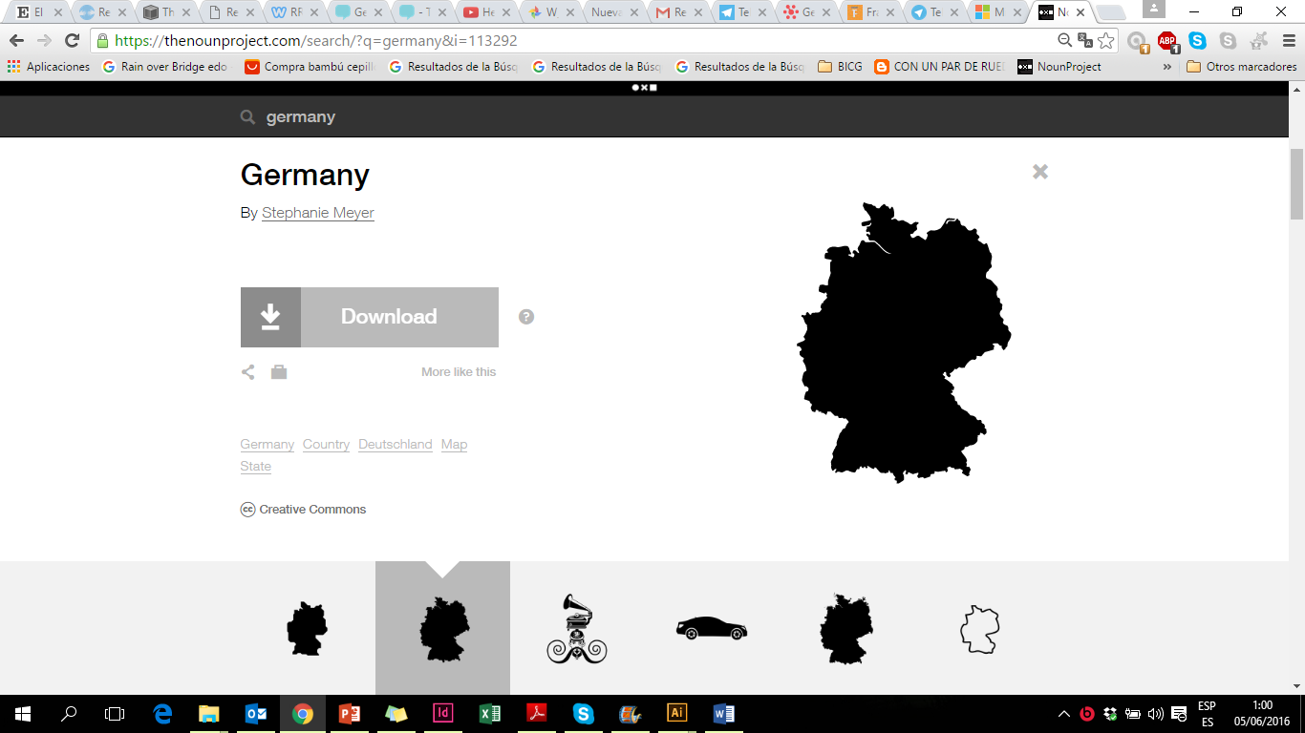
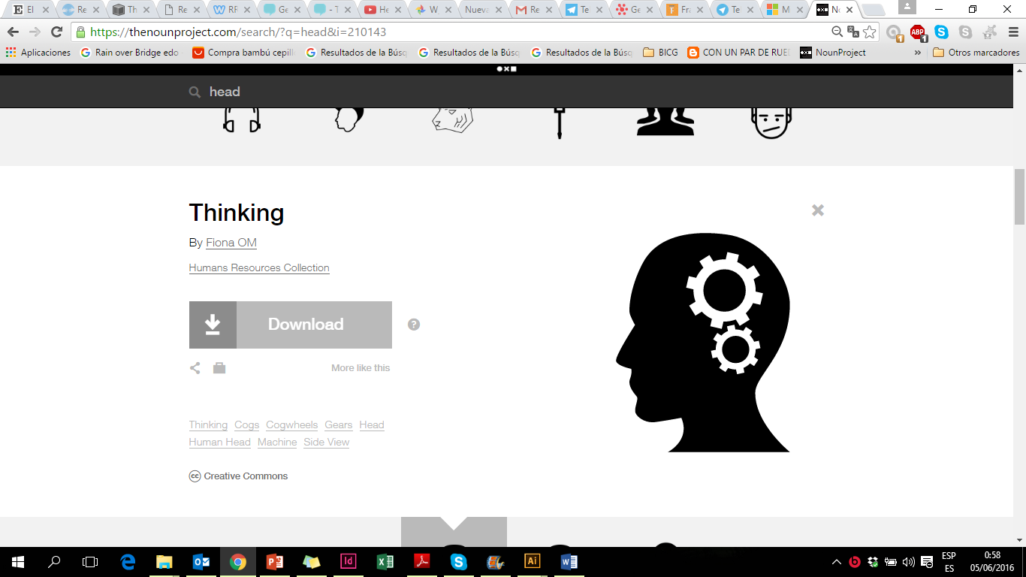
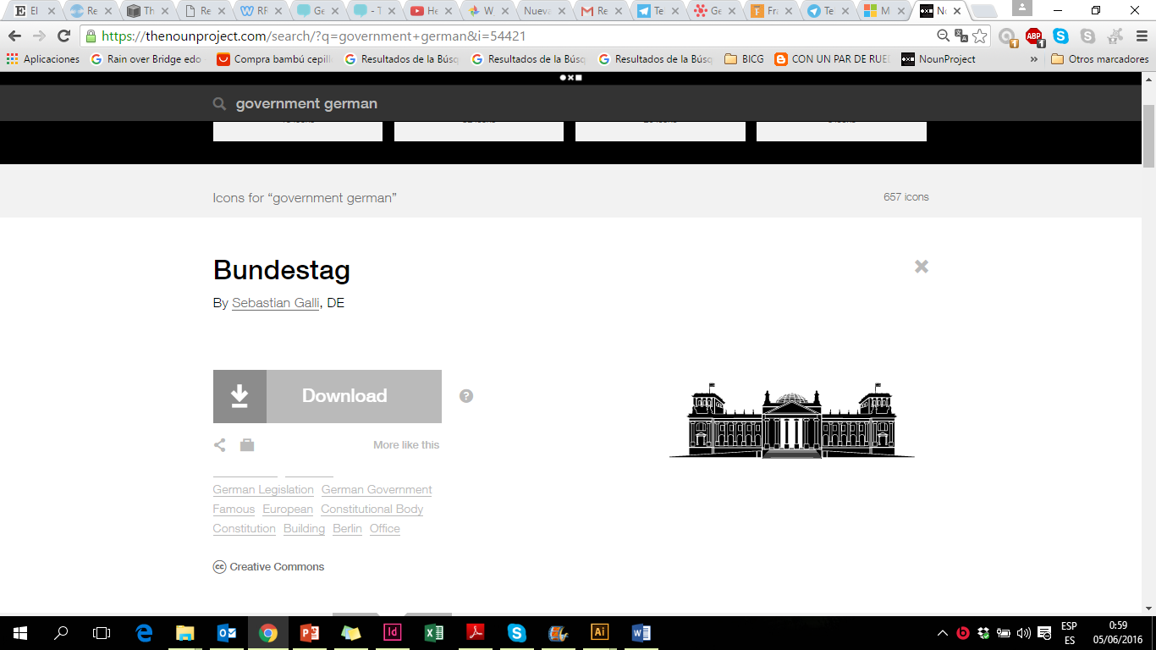
Target groups

Slide 6
talktoHadi
The meaning of Hadi
مرحبا هادي

Slide 7
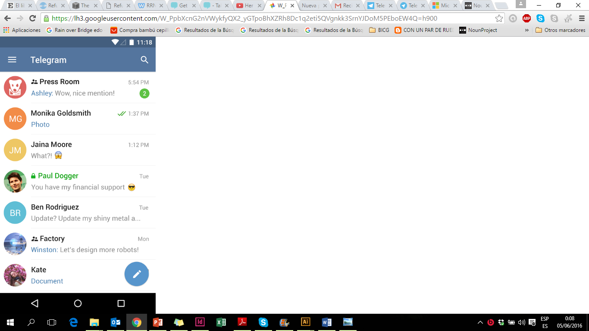
How it works

Slide 8
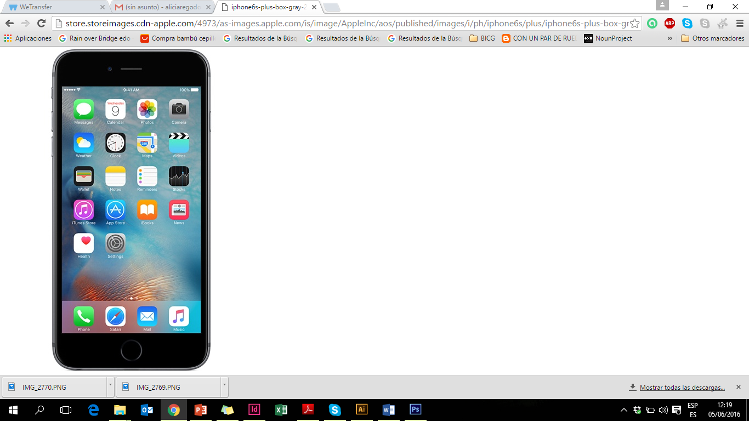
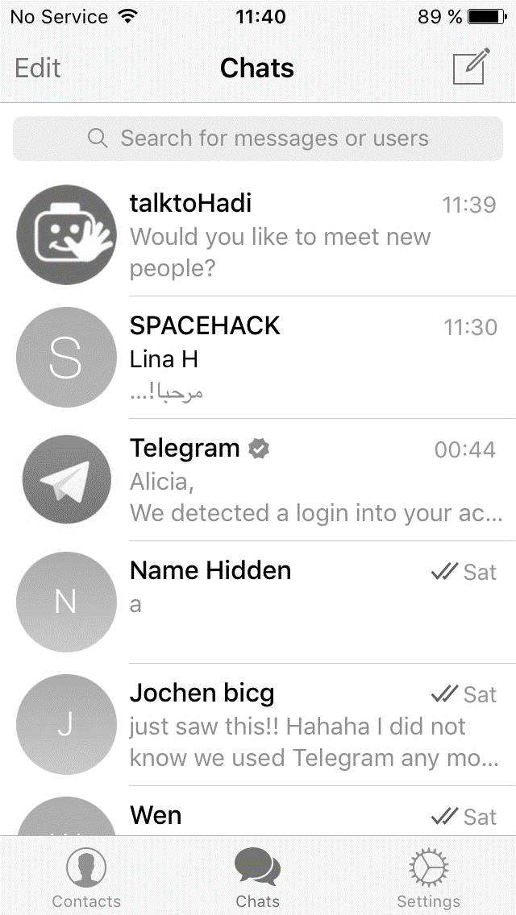
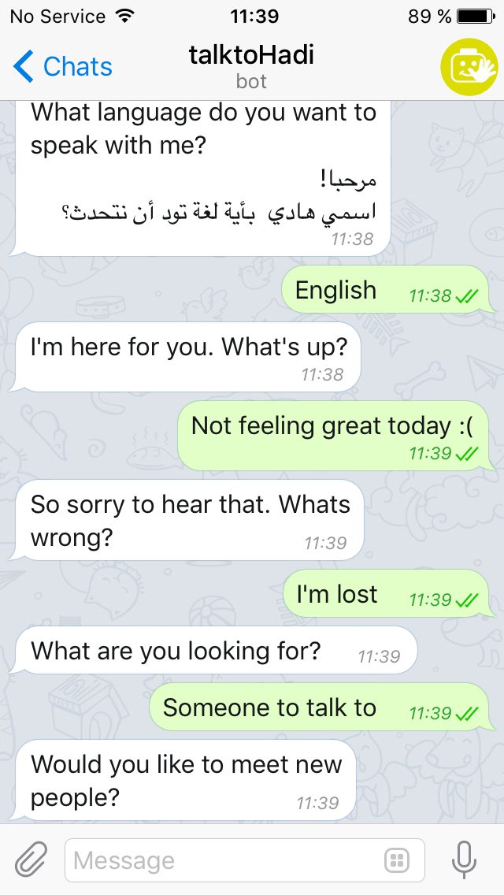
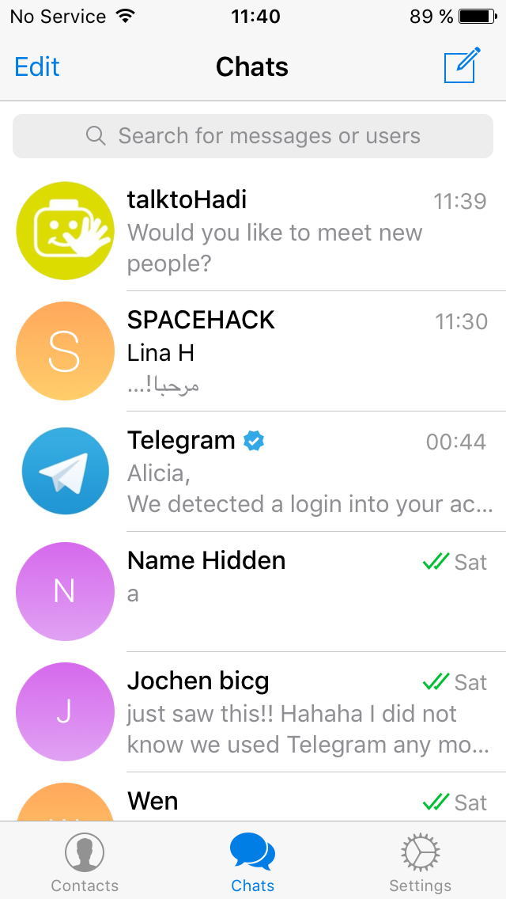
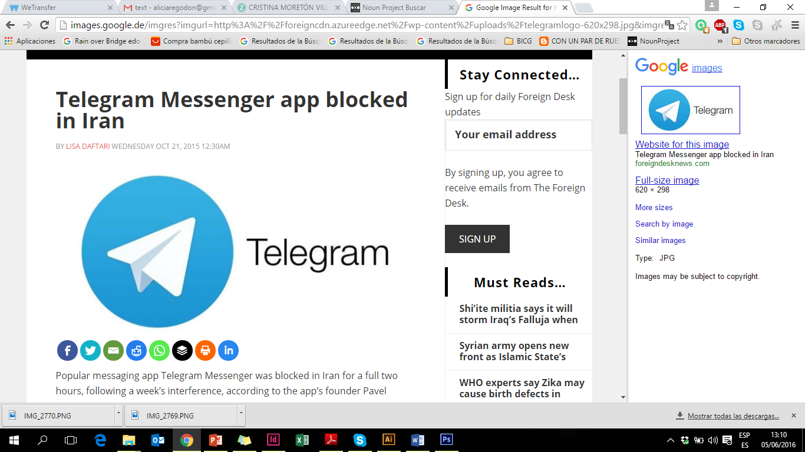
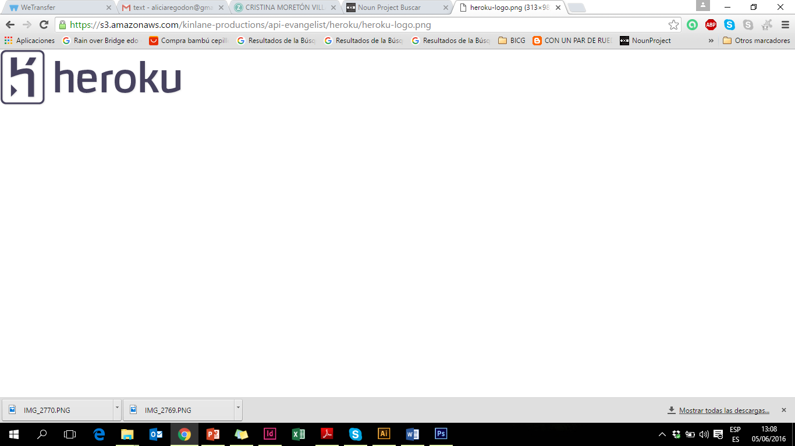
How it works

Slide 9


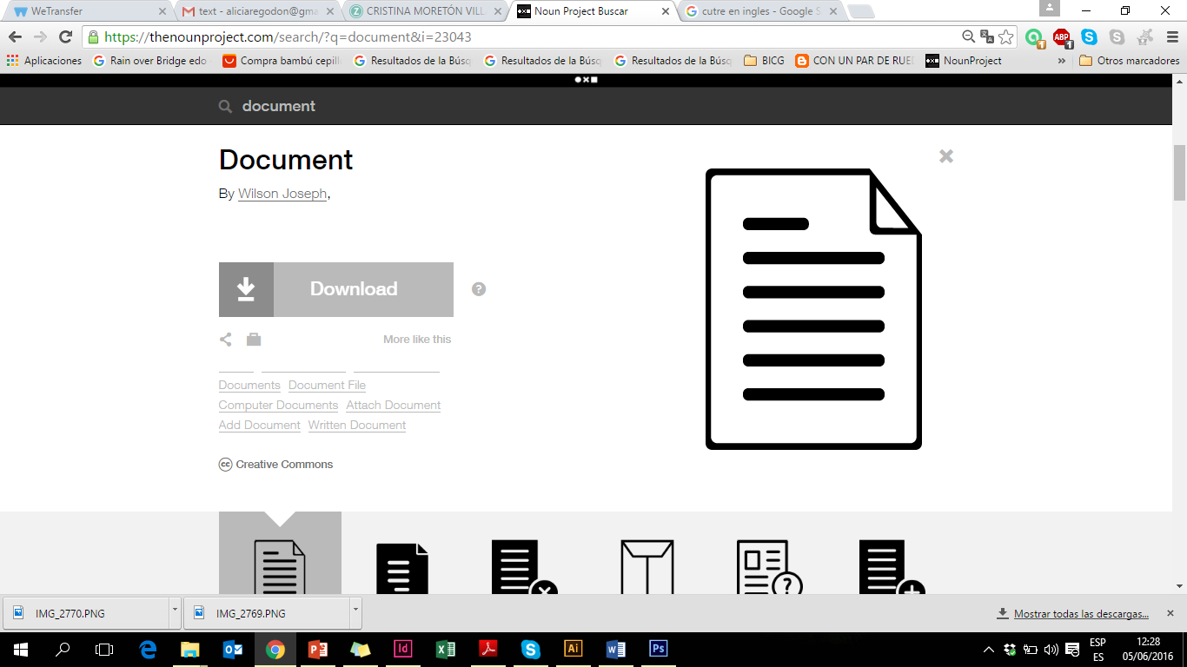
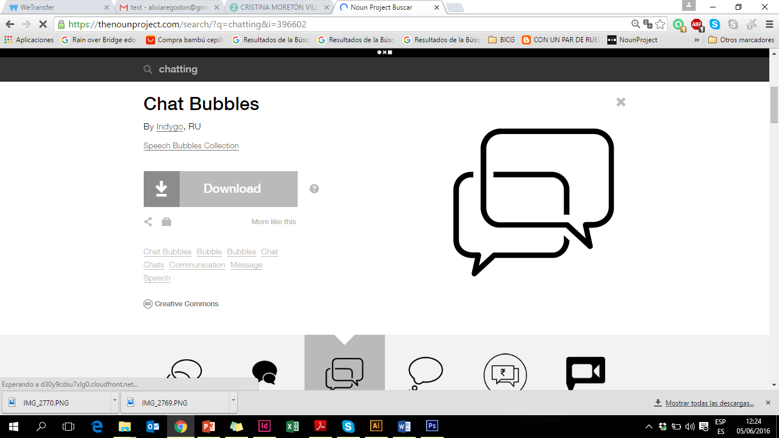
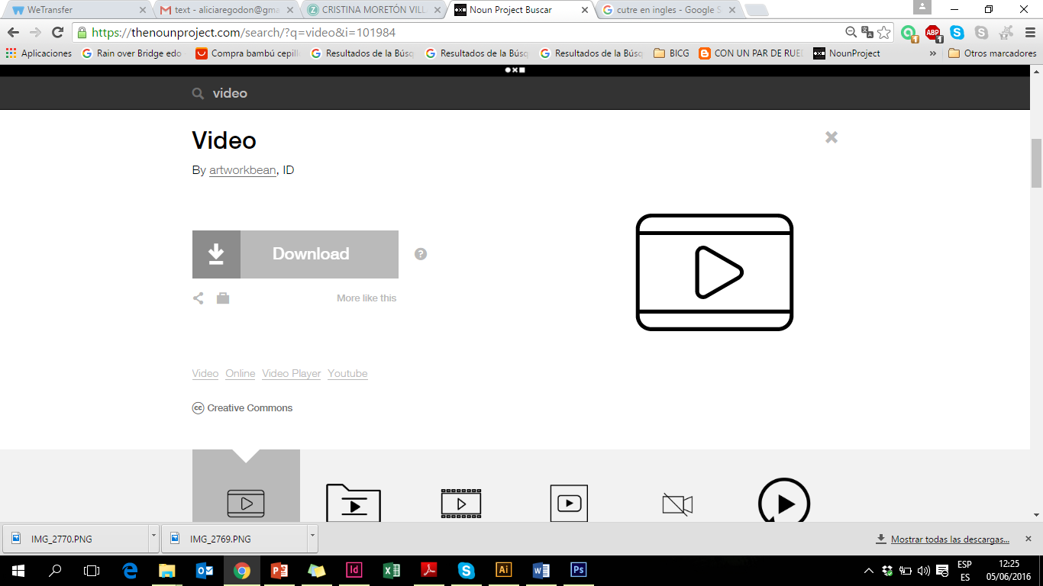
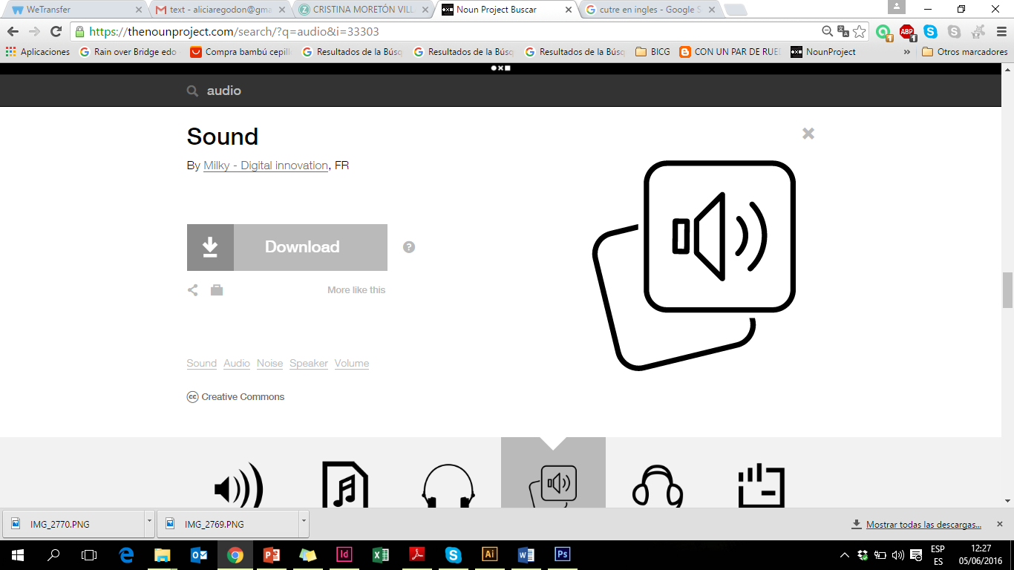
Input
Different scenarios we are facing
Hotline numbers:
Germany Suicide Hotlines
Association of Women's Shelters
Urgent cases
talktoHadi
Psychologycal
First Aid
Redirect to:
Bureaucrazy
Radio Refugee
Eduapp4syria
wehostrefugees
Not relevant

Slide 10
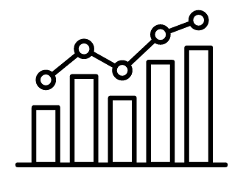
Sustainability & Challenges
First month
Six month
Psychological needs
Full
Translation
Strong
community
Progress
tracking

Slide 11
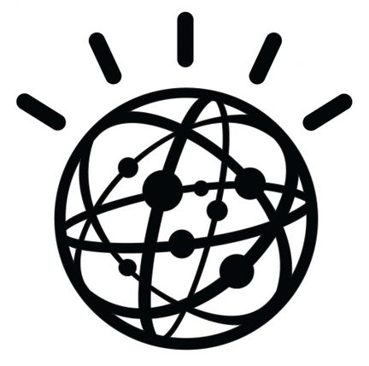
Sustainability & Challenges
Psychological needs
Full
Translation
Start
community
Strong
community
Progress
tracking
Watson´s
integration

Slide 12
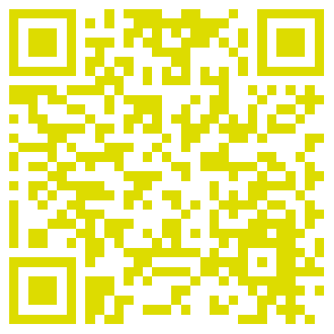
Building a community
@talktoHadi
@talktoHadi
talktoHadi
talktohadi@gmail.com

Slide 13
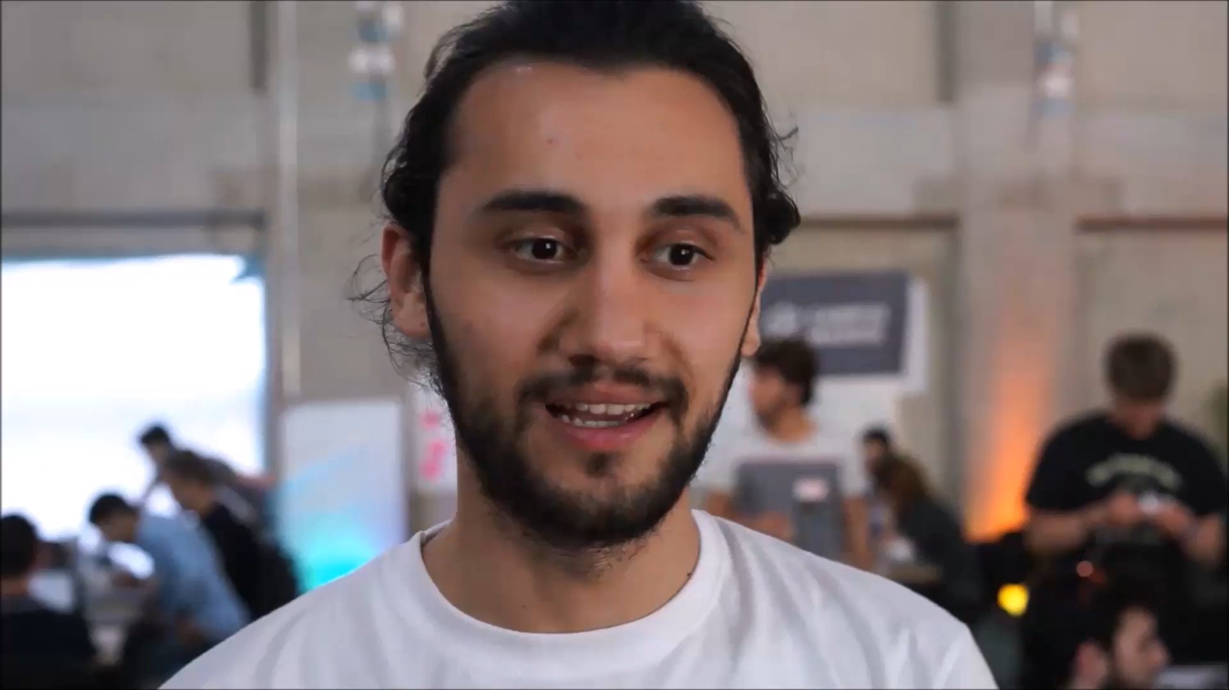

Slide 14
So… How are you feeling today?
try it on Telegram now
talktoHadi

